Slide 1
CS427 Final Project
Group 1

Slide 2
Team Members
Name | NetID | UIN
David Huang | davidh9 | 659864139
Ruikang Zhao | ruikang2 | 677547925
Qin Qin | qinq2 | 671155975
Mingwei Huang | mingwei6
Terry Yu | tyu22 | 679942018
Jiaxin Ying | jiaxiny7 | 657273660
Dansong Zhang | dzhang31

Slide 3
Projects Selected
Joinery and Qulice
Introduction of group’s selected open source projects: This should include the names of
the projects, links to the repositories, and one sentence description of each selected
project. (2 points)

Slide 4
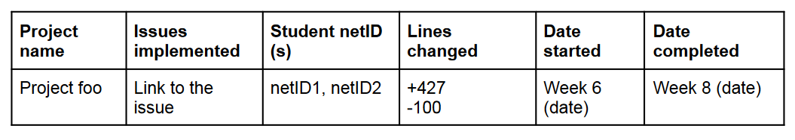
Timeline
How well does your team follow the timeline? Explain with screenshots of version
histories in GitHub. (2 points)
Will need to spread across multiple slides

Slide 5
Issues Discussions
Each team member will add their own slides corresponding to their own issues. It must have the following content:
Screenshot and explanation of issues implemented (5 points)
○ What was the issue, what was your solution to the issue, how did you implement
the solution
● Tests added for the issues (4 points)
○ If there are no tests, explain why and describe the scenario
● Screenshots to show results of static analysis tools on your modified code portions.
This should include the initial result (the first time you run these tools and the error they
show) as well as the final state. (3 points)
○ -1 points for not showing results for Findbugs
○ -1 points for not showing results for PMD
○ -1 points for warnings still remain in code, unless there is a justification for it (for example, you have manually investigated the warnings and errors, and they are false positives)

Slide 6
<Project>, <Issue #>, <Your Name>
Feel free to spread this across multiple slides. I think the following order/setup would work
Issue Description
Description of Issue
Screenshot of issue if able to reproduce
Solution
Tests for solution as well
PMD and FindBugs

Slide 7
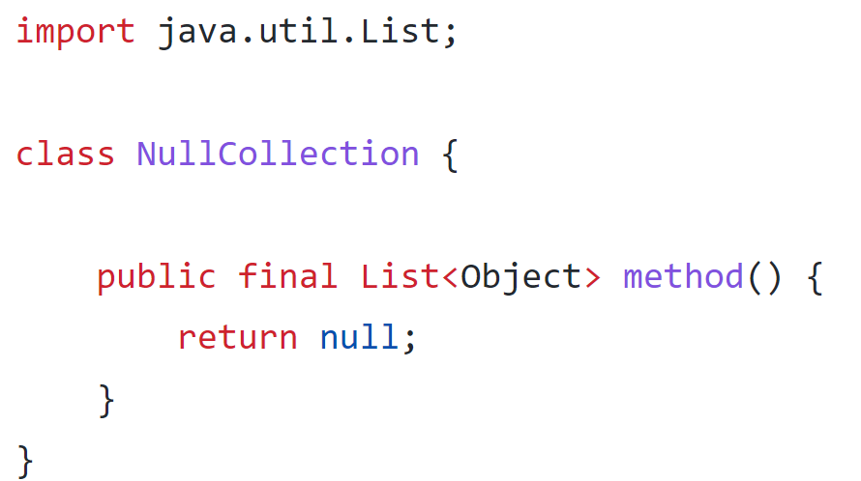
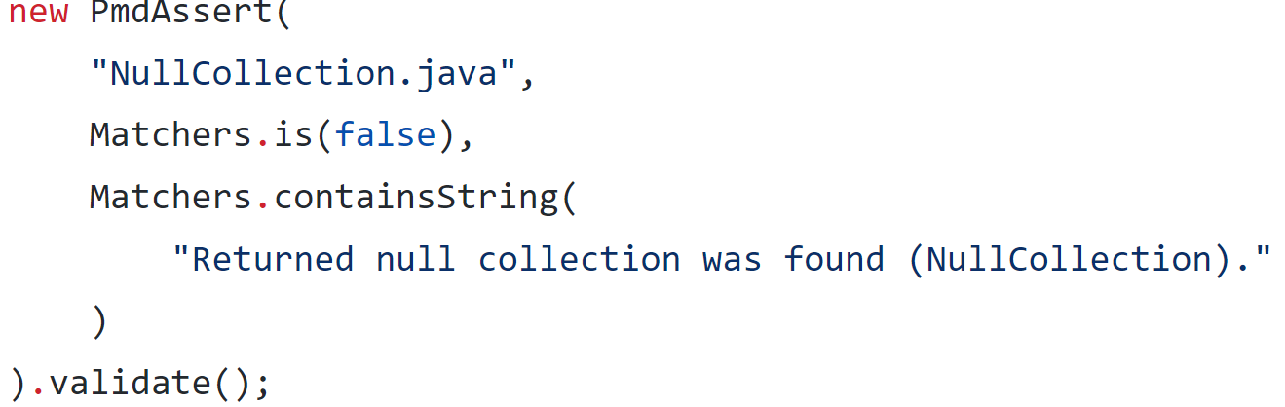
Qulice, #793, Mingwei Huang
Issue Description
Qulice does not have the rule for functions with collection type to return non-Null collection.
Test to reproduce the issue:

Slide 8
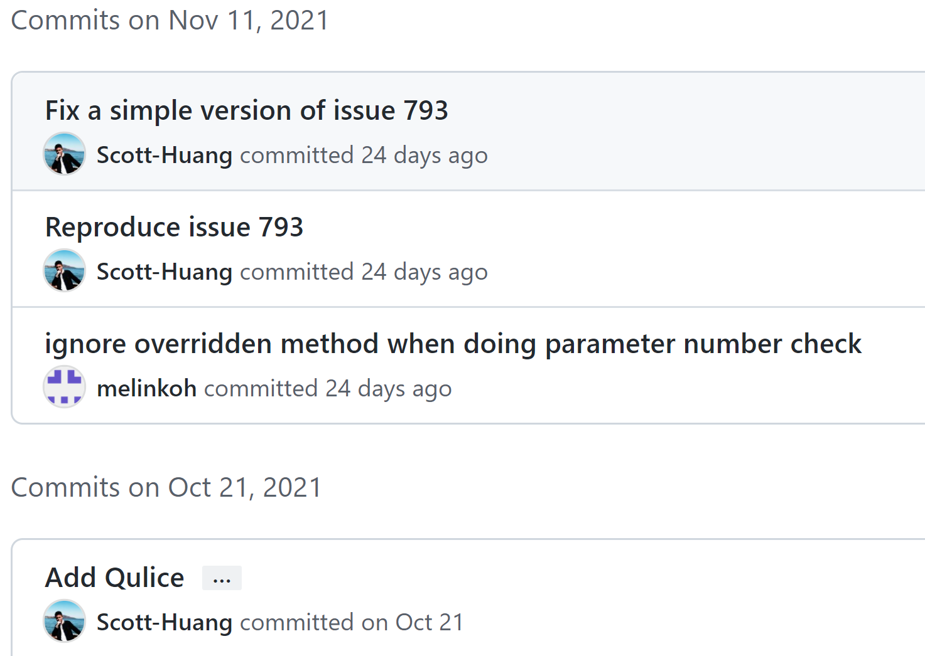
Qulice, #793, Mingwei Huang
Project name | Issues implemented | Student netID | Lines changed | Date started | Date completed
Qulice | 793 | mingwei6 | +78, -0 | week 6 | week 10
Timeline
1 week for setting up the project repo and start the project. 1 week read and understand the code, 1 week to reproduce the issue and read PMD repo, 1 week to fix the issue.

Slide 9
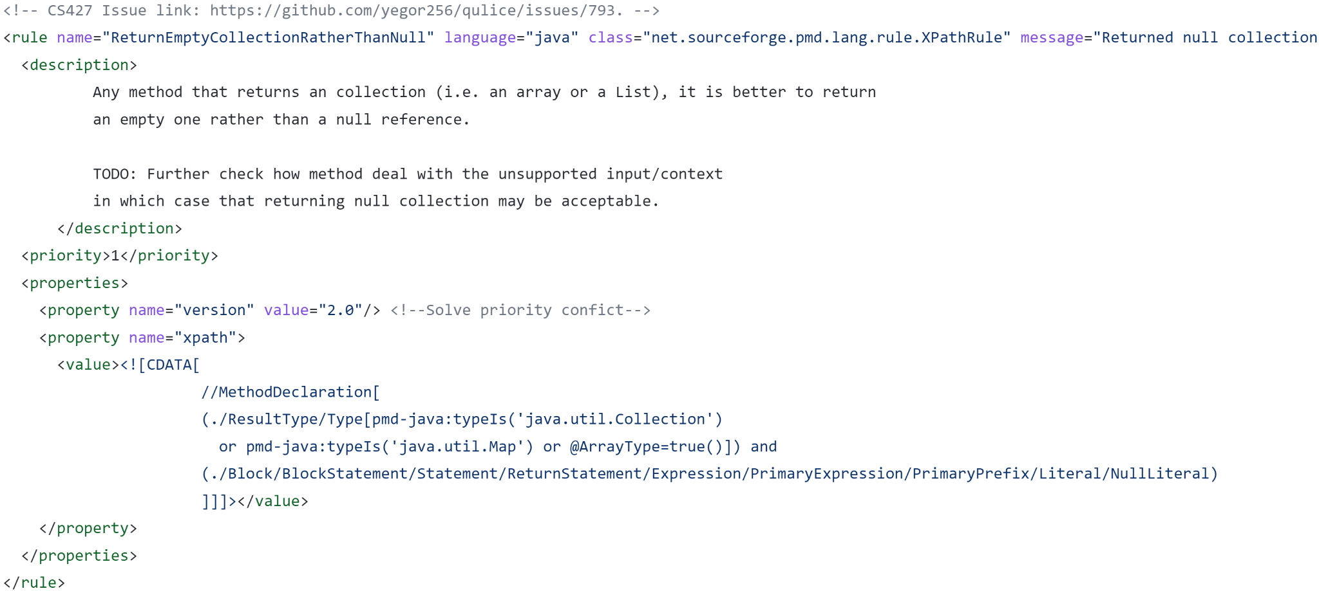
Qulice, #793, Mingwei Huang
Solution
I located the corresponding section in the pmd folder and went over the PMD github repo to learn the use of PMD. Then I added an additional rule for returning empty collections.
The rule was implemented by finding all functions with return type being collections, and find all their return statements that is returning null.

Slide 10
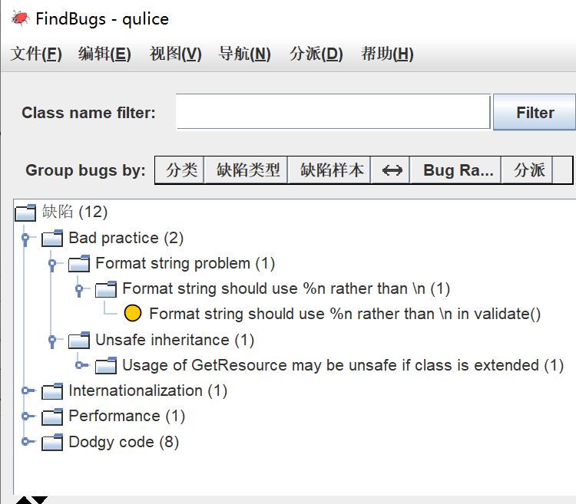
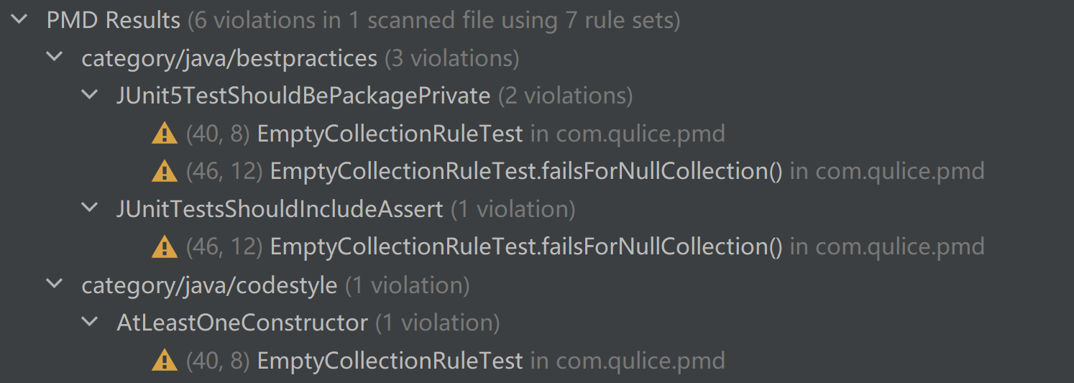
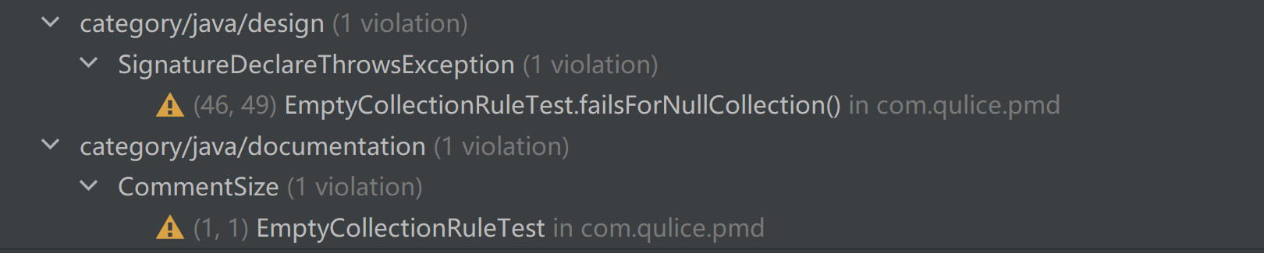
Qulice, #793, Mingwei Huang
FindBugs and PMD
No new bug was introduced. All PMD errors are justifiable:
(The original project also have these 12 bugs)
Some are false-positive and some is the legacy of the original repo, it is impractical to refactor the entire project to change it.

Slide 11
Conclusion
Difficulty: Large project, need to learn PMD ruleset.
Lesson: Try to make as little modification as possible.

Slide 12
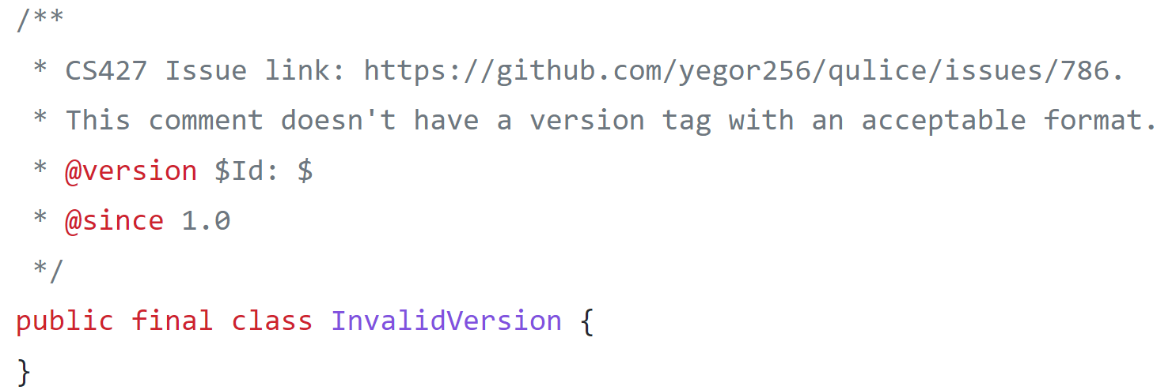
Qulice, #786, Mingwei Huang
Issue Description
Qulice does not explain where is format error of the author and version Javadoc tags.
Test to reproduce the issue:
Modified:

Slide 13
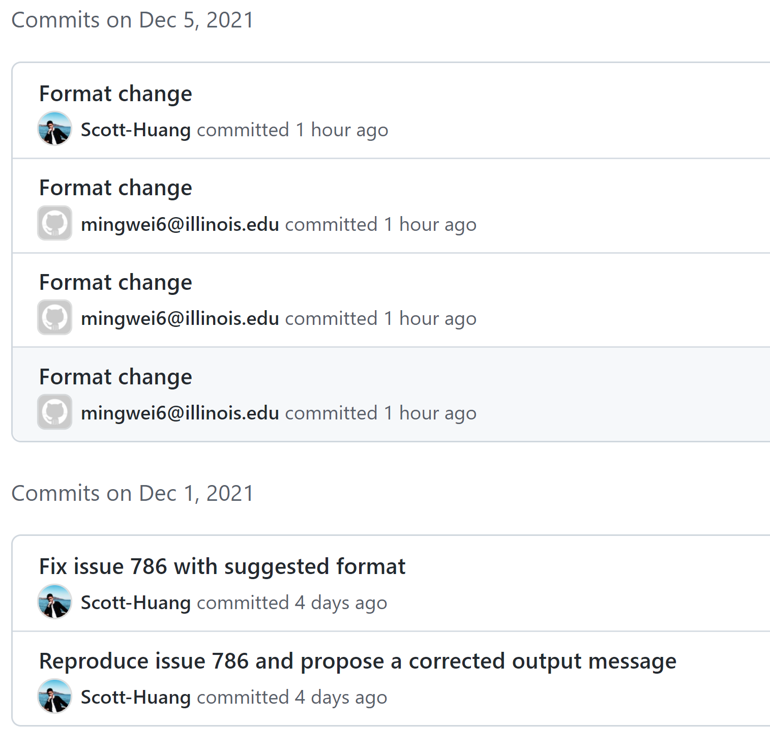
Qulice, #786, Mingwei Huang
Project name | Issues implemented | Student netID | Lines changed | Date started | Date completed
Qulice | 786 | mingwei6 | +29, -2 | week 11 | week 12
Timeline
1 week to read and find corresponding code, 1 week to reproduce and fix the issue.

Slide 14
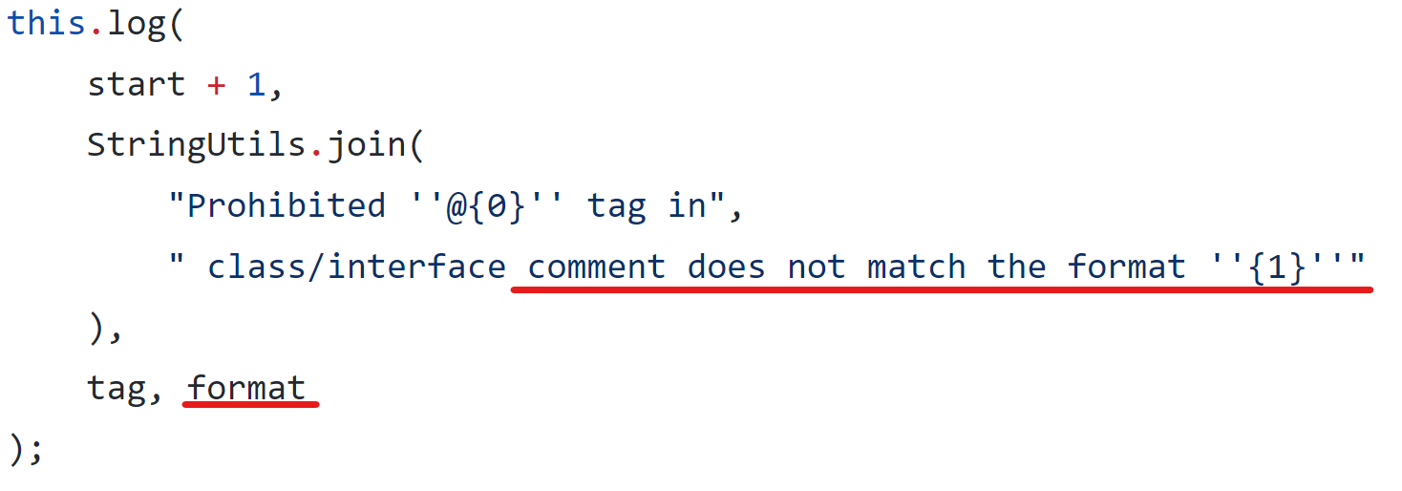
Qulice, #786, Mingwei Huang
Solution
I located the corresponding part in the checkstyle section, and soon realized that the problem did not have a definitive solution. I then decided to solve this issue with more detailed warning message.
Adding suggested format in the output message:

Slide 15
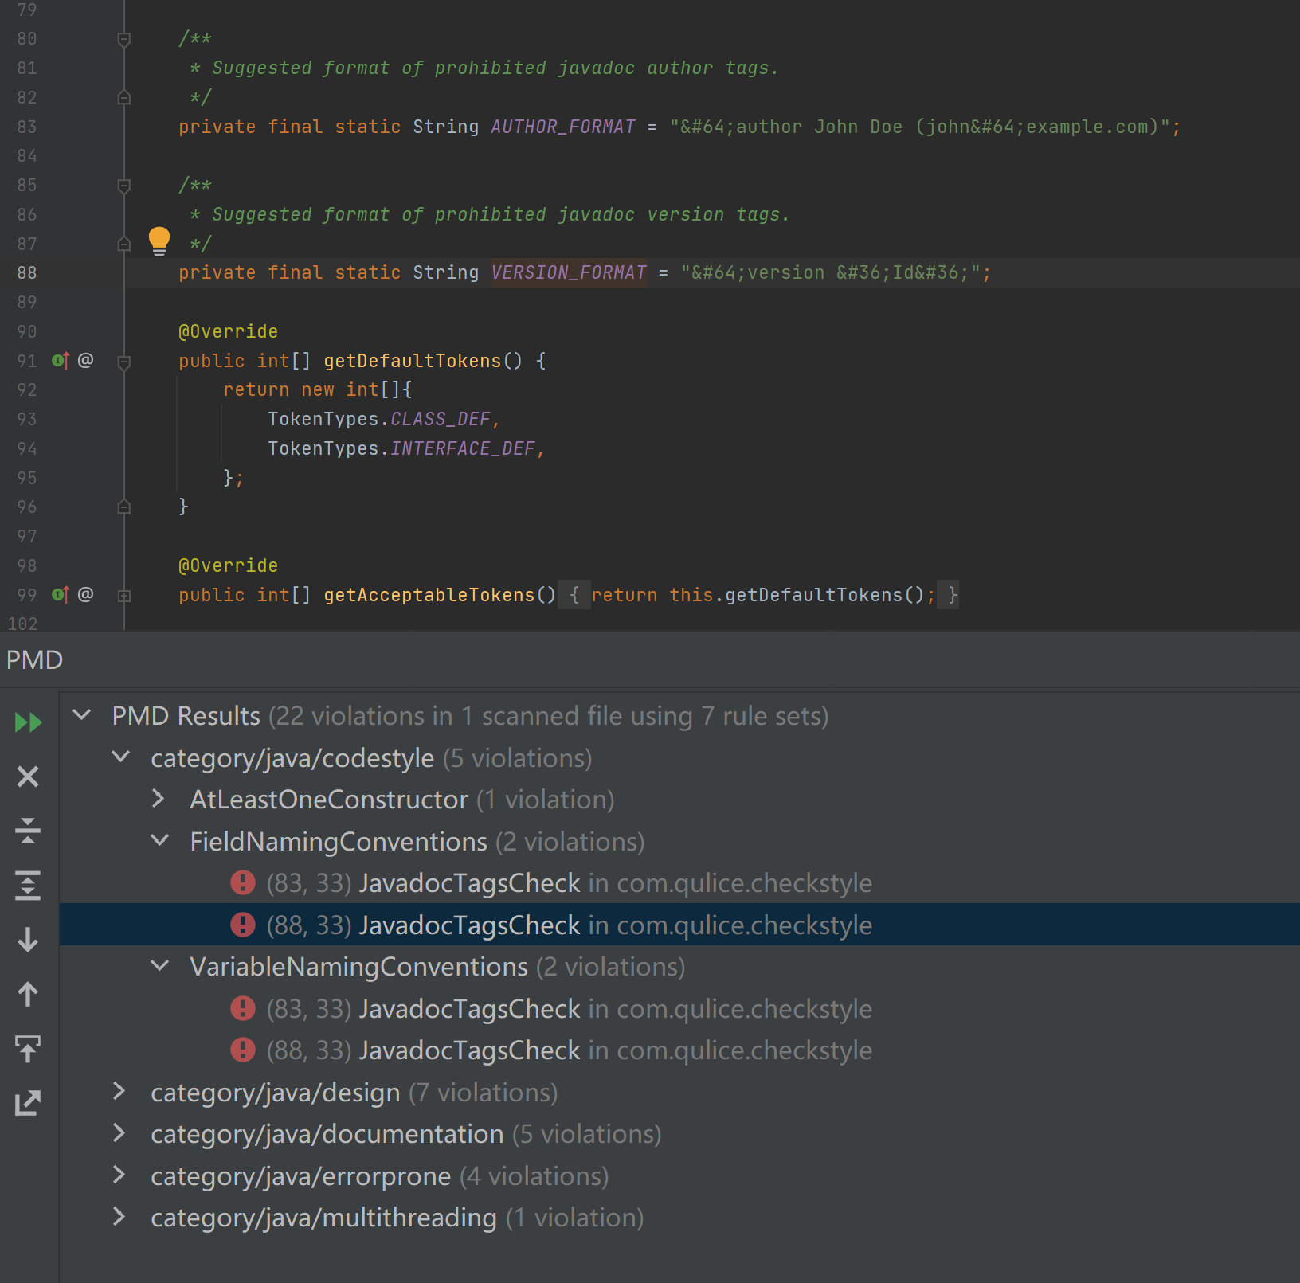
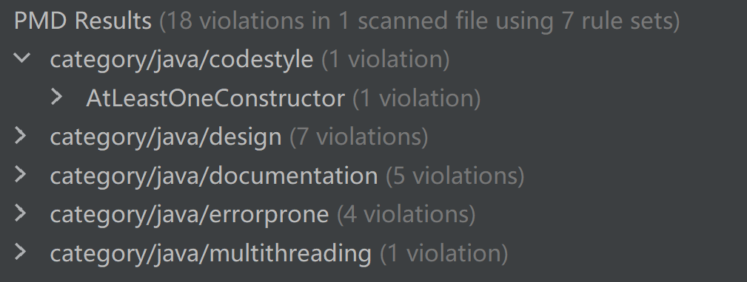
Qulice, #786, Mingwei Huang
FindBugs and PMD
No new bug was introduced. PMD errors:
(The original project also have these 12 bugs)
Only errors are the variable naming, no other introduced errors after fixing.

Slide 16
Conclusion
Lesson: Many problems, like this one, do not have a definitive answer. One can define the solution based on the existing architecture and tools in order to have a minimum change to the code.

Slide 17
Joinery, Issue #82, David Huang
Issue Description
https://github.com/cardillo/joinery/issues/82
Issue #82 is a feature request for adding a mode algorithm on data frames. Mode, in statistics, represents the values that appear most often in a set of data values. Joinery currently doesn’t provide such a function or algorithm that directly calculates it. Mode is one of the most basic and frequently used statistics in any modern data analysis project. I felt that this feature is an important feature that must be added to Joinery sooner or later, which aligns with the goal of Joinery, a data analysis library that operates on dataframes in Java.

Slide 18
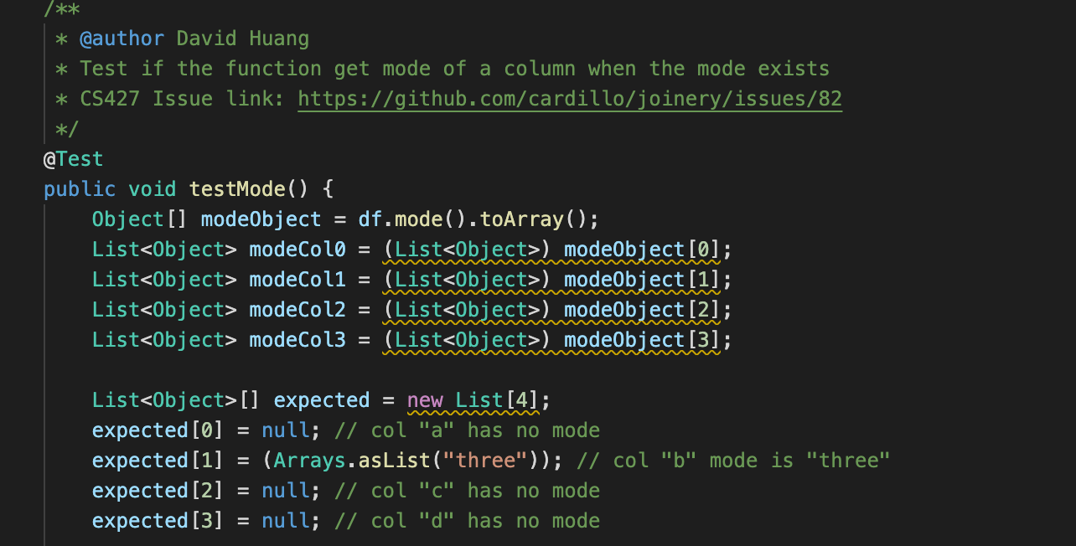
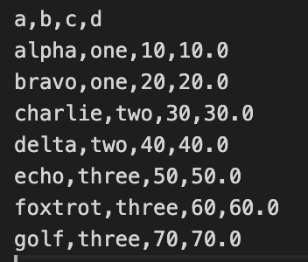
Joinery, Issue #82, David Huang
Solution
I spent some time researching if there is a mode() function within these libraries. however, there isn't.
I implemented the mode() function from scratch. I created an initial hashTable to keep track of the count for each value from a set of given data values, usually these data are from a column of a dataframe. After iterating through all the values, we can calculate the mode, which has the most count out of all the other values. The time complexity for this algorithm is O(N), and the space complexity is O(N), where N is the size of the data set.

Slide 19
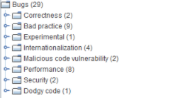
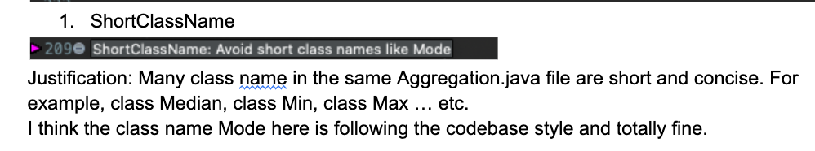
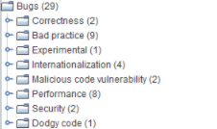
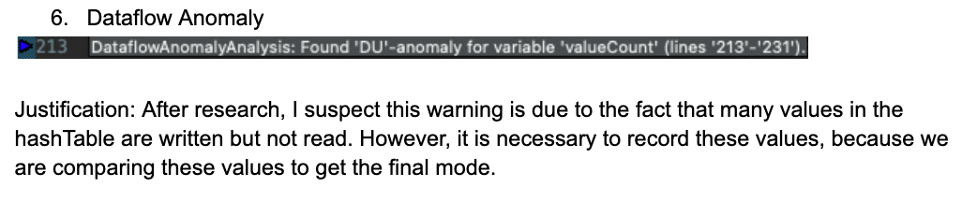
Joinery, Issue #82, David Huang
PMD and FindBugs
After fixing 4 PMD issues, we have 2 warnings left with justification.
No new bugs are found in FindBugs.
Before
After

Slide 20
Joinery, Issue 74, Jiaxin Ying
Project name | Issue implemented | Student netID | Lines changed | Date started | Date completed
Joinery | 74 | jiaxiny7 | 28 | Week 3 | Week 4
Issue description: Currently, there is no public method for users to get the column index corresponding to the specific column name, and there is no trivial way to do that because columns is a private member of the class Dataframe.
However, some functions take indexes as inputs, like the drop function with signature public DataFrame<V> drop(final Integer ... cols), so that’s why it is important to provide users with the method which can get the column index given the column name.

Slide 21
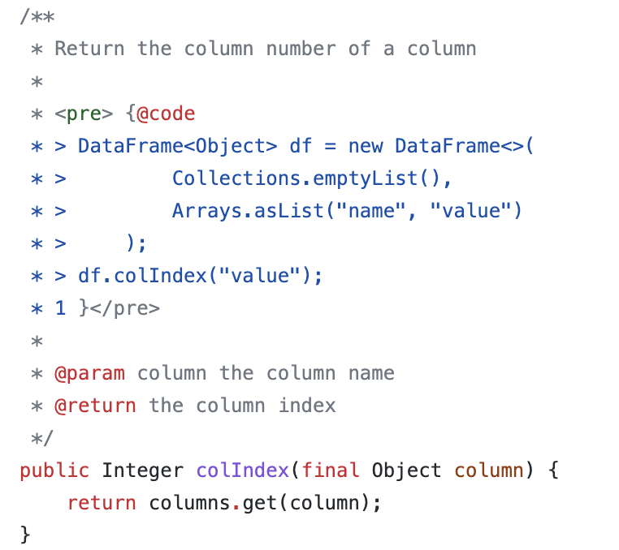
Joinery, Issue 74, Jiaxin Ying
Solution: call the method provided by Index class
Test case scenario: I construct a dataframe with column names as col1, col2, col3 in order. So when retrieving the column index for these three columns, the result will be 0, 1, 2 respectively.
In another case, when finding the index given the column name “value”, the system should throw an exception for illegal arguments.

Slide 22
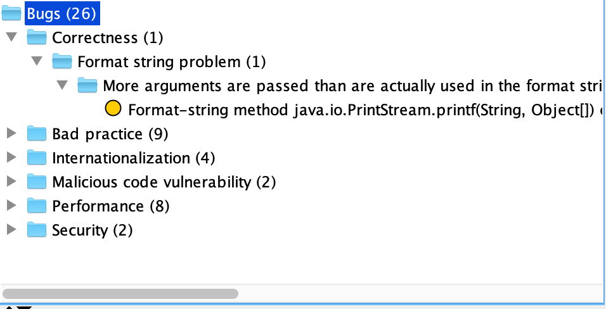
Joinery, Issue 74, Jiaxin Ying
No new bug introduced for FindBug
PMD report for Joinery Issue 79
See detailed report by the link
Some useful tips pointed out by PMD
Local variables only assigned once should be declared final
Use diamond operator to avoid duplication
Some errors are valid
I.g. only have one assert in test function.
I think the key is to test one concept and one scenario in each test function, and contain multiple asserts might be ok if testing one thing.

Slide 23
Joinery, Issue 79, Jiaxin Ying
Project name | Issue implemented | Student netID | Lines changed | Date started | Date completed
Joinery | 79 | jiaxiny7 | 161 | Week 5 | Week 6
Issue description: Previously, JoinOn method can only perform join operation on two data frames that have exactly the same column names for the join key. However, sometimes users may want to join two dataframes with different column names. Therefore, it’s important to extend the functionality to support join operation in a more flexible way.

Slide 24
Joinery, Issue 79, Jiaxin Ying
Solution:
Allow users provide a map for specifying the join keys, with keys as column names of the left table and values as corresponding column names of the right table. Then compared with original version, I perform multiple rename operations before and after the join.
Test Scenario:
The left dataframe has columns “key”, “a”, “value”, the right dataframe has columns “key”, “b”, “value”, they perform left join on “key”. The values and column names of the result dataframe are checked.
Now the right dataframe has columns “index”, “b”, “value”, and the left dataframe keeps the same as before. They join on the column “key” for the left data frame and “index” for the right data frame.
Test the case of outer join
Test the case of inner join
Test the case of join on two columns.

Slide 25
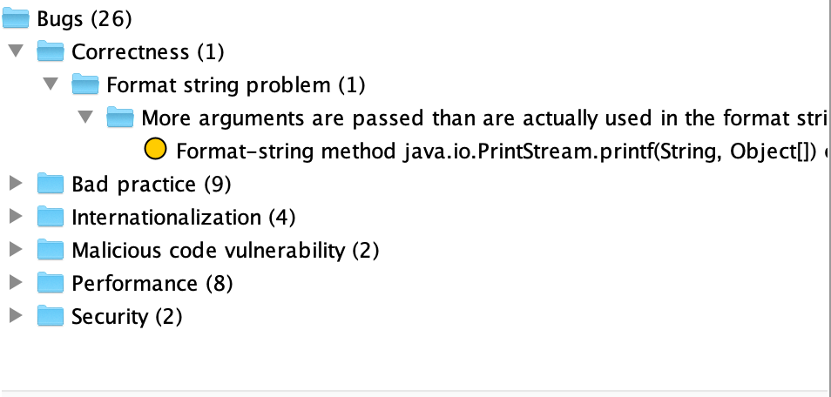
Joinery, Issue 79, Jiaxin Ying
No new bug introduced for FindBug
PMD report for Joinery Issue 79
See detailed report by the link
Some useful tips pointed out by PMD
Short variables are not helpful for users to understand meanings
Assertion should contain message

Slide 26
Joinery, Issue 94, Jiaxin Ying
Project name | Issue implemented | Student netID | Lines changed | Date started | Date completed
Joinery | 94 | jiaxiny7 | +111, -27 | Week 6 | Week 8
Issue description:
Originally writesql function didn’t support users to specify the chunksize parameter. If the user want to write a large amount of data to the database, it will cause burden to the sql server, as the server may have limited memory. The improvement is to add a chunksize parameter to control the number of rows written to the database each time.

Slide 27
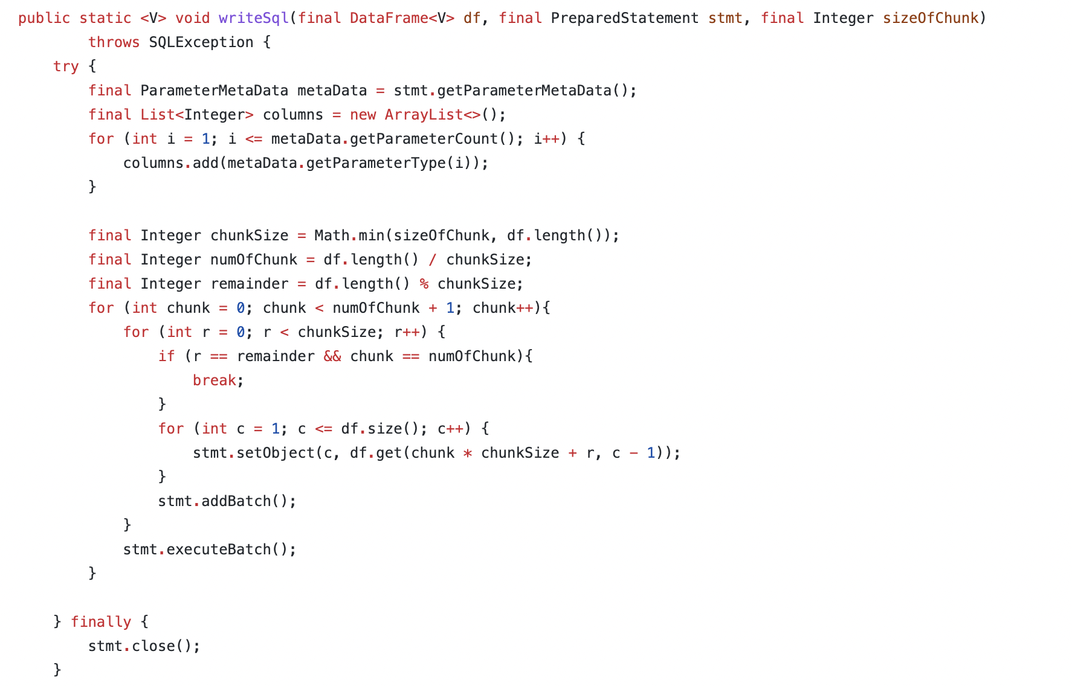
Joinery, Issue 94, Jiaxin Ying
Solution: Originally, the writesql function calls the executeBatch function only one time, and write all rows at once. Now I overload the original function to add a chunksize parameter, and execute the executeBatch function multiple times in a loop.
Test Scenario:
I first construct a dataframe with multiple columns and multiple values. Then I call the readsql function after the writesql function, and compare the result with the original dataframe. By doing so, I can make sure that the writesql function can write correct values. Moreover, I use a loop to test on different chunksize parameter, including the boundary case, for example, when the number chunksize is greater than the total rows of the target dataframe.

Slide 28
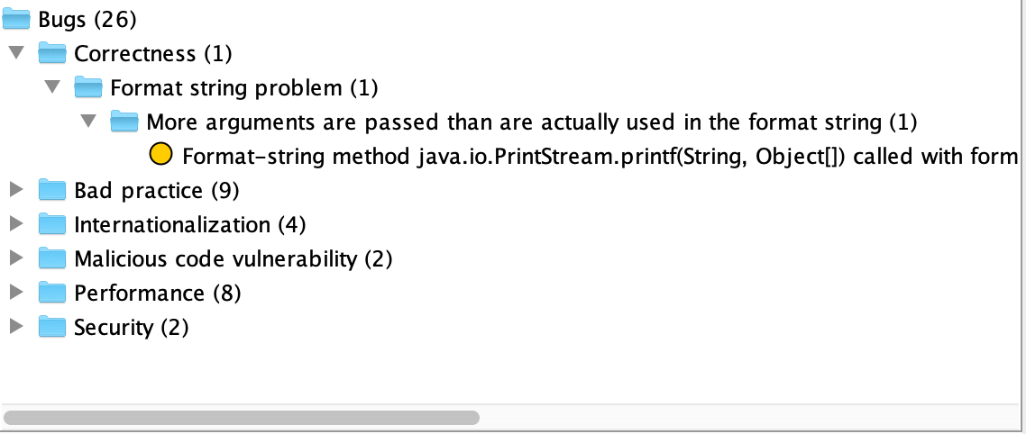
Joinery, Issue 94, Jiaxin Ying
No new bug introduced for FindBug
PMD report for JOINERY issue 94
See detailed report by the link
Some justifications
Not necessary to add comments before test functions, since the function name and parameters explain the meaning and authors didn’t do that.
Not necessary to use ConcurrentHashMap, when concurrency is not supported.
Need to change original design in order to solve the problem of law of demeter

Slide 29
Concluding Remarks
○ What lessons did you learn from your project?
○ What was difficult?
○ What do you wish you could have done (or done differently)?
○ How could your project be extended...what's next? Are there any interesting
problems or questions that resulted from your work?

Slide 30
Joinery, Issue#40, Ruikang Zhao
Project name | Issue implemented | Student netID | Lines changed | Date started | Date completed
Joinery | 40 | ruikang2 | +282, -14 | Week 6 | Week 8
Issue Description:
It is an enhancement issue to improve the efficiency of “sorting” / “grouping” such as avoiding copies, making efficient use of memory, parallelization, etc.
Reference Insight: http://wesmckinney.com/blog/mastering-high-performance-data-algorithms-i-group-by/

Slide 31
Joinery, Issue#40, Ruikang Zhao
Based on the reference, I took the following steps to address the improvement on “sorting”:
Figured out how to use the existing sorting algorithms(by writing the test examples to csv files and try out several cases on the tests)
Understood the implementation of the existing sorting algorithms
Added several unit tests to justify the correctness of the existing sorting algorithm:
Implemented a counting sort algorithm that takes O(n)
Provided corresponding unit tests, Javadocs, Findbugs report and PMD results.

Slide 32
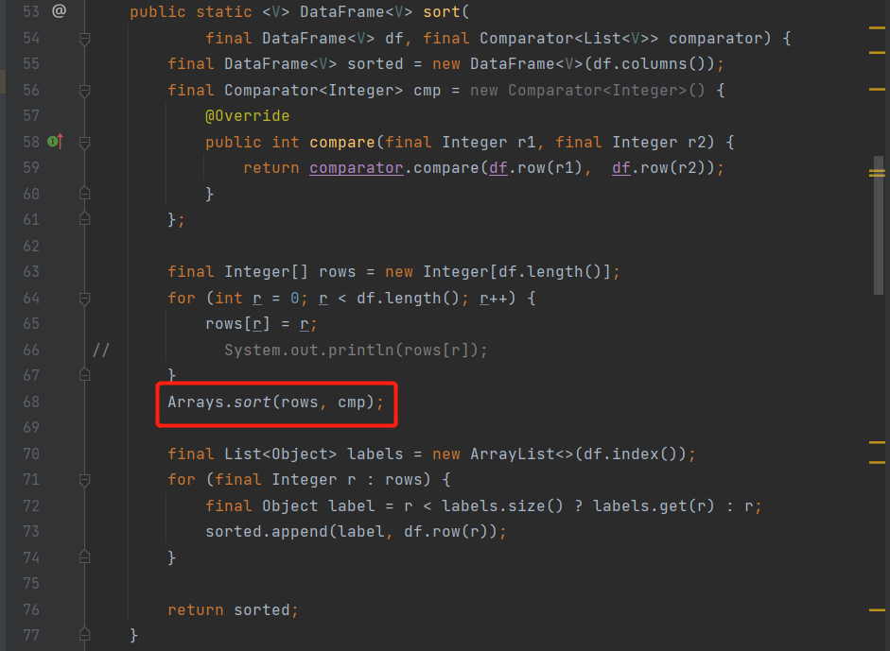
Joinery, Issue#40, Ruikang Zhao
The original sort implementation defines a comparator on data frame objects, base on the given column to be sorted, and then simply uses the “sort” api provided in Java library“Arrays”.

Slide 33
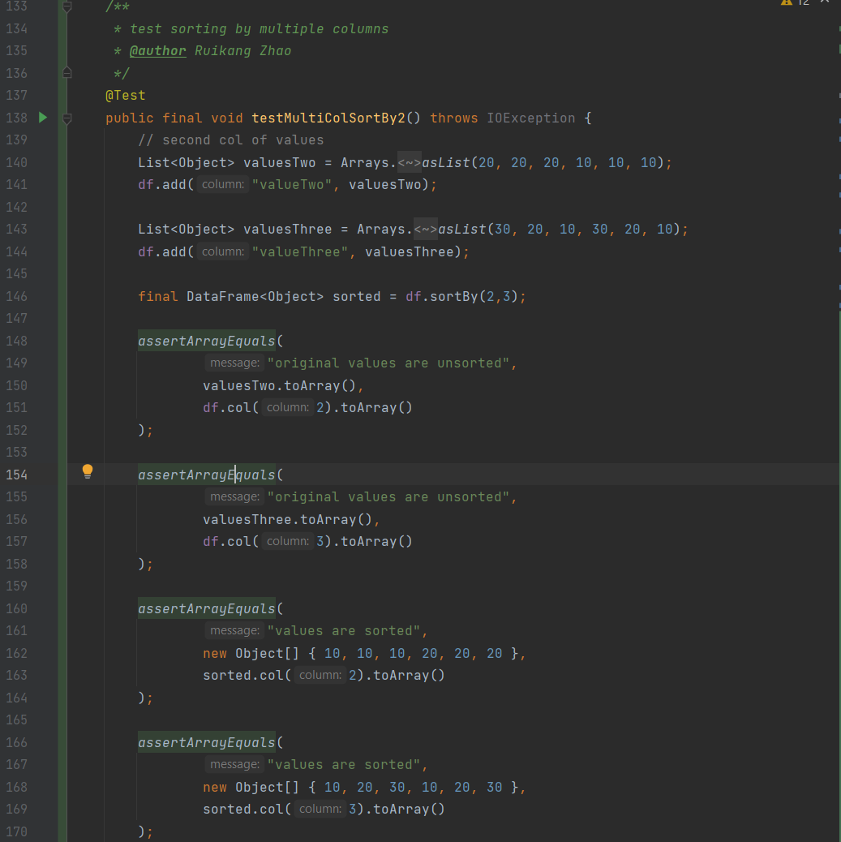
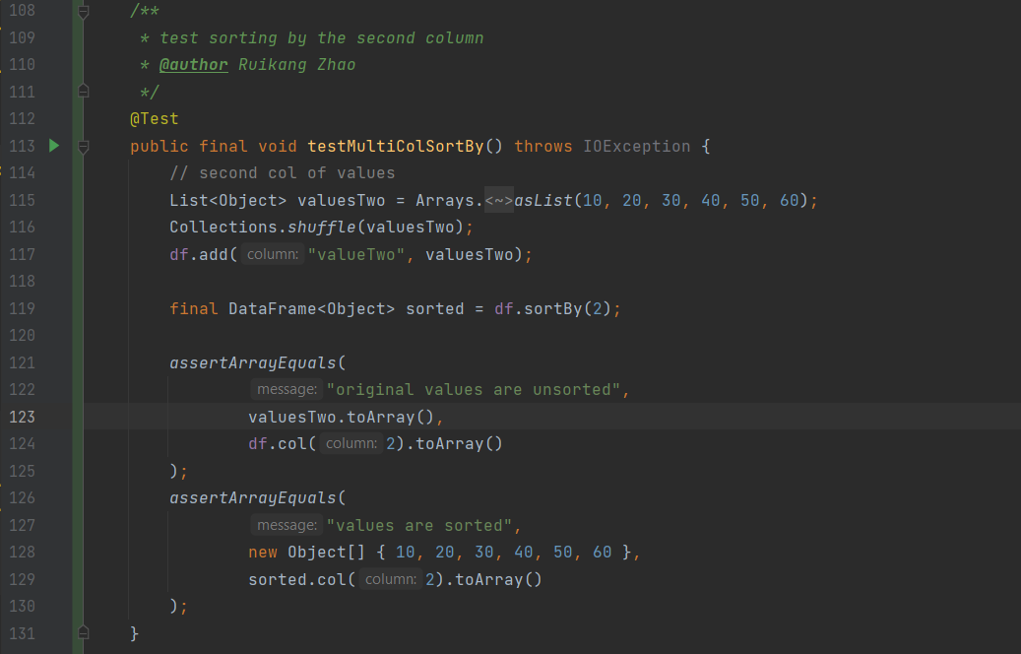
Joinery, Issue#40, Ruikang Zhao
I added two more unit tests to understand how to use the existing “sortBy” method in Dataframe class, and how it relates to the “Sorting” implementation.

Slide 34
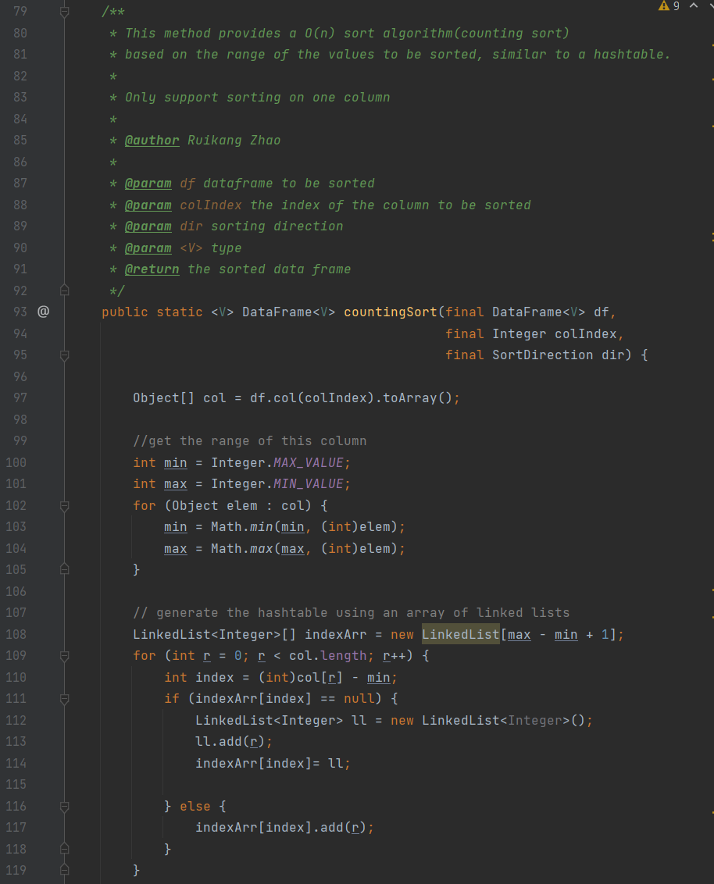
Joinery, Issue#40, Ruikang Zhao
From here, I provided my counting sort implementation based on the insight:
“O(n) sort, known in pandas as groupsort, on integers with known range. This is a variant of counting sort; if you have N integers with known range from 0 to K — 1, this can be sorted in O(N) time. Combining this tool with factorize (hash table-based), you can categorize and sort a large data set in linear time. Failure to understand these two algorithms will force you to pay O(N log N), dominating the runtime of your algorithm.”

Slide 35
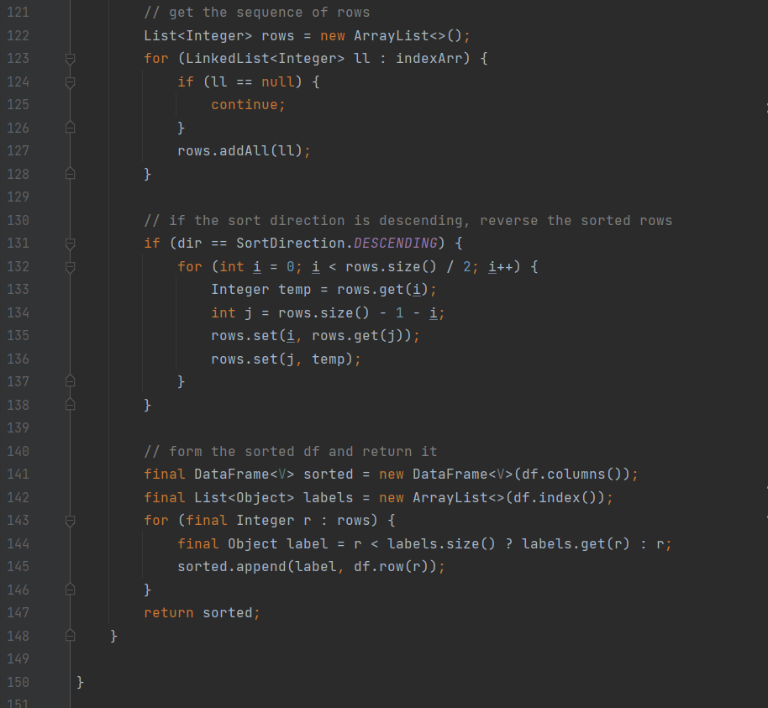
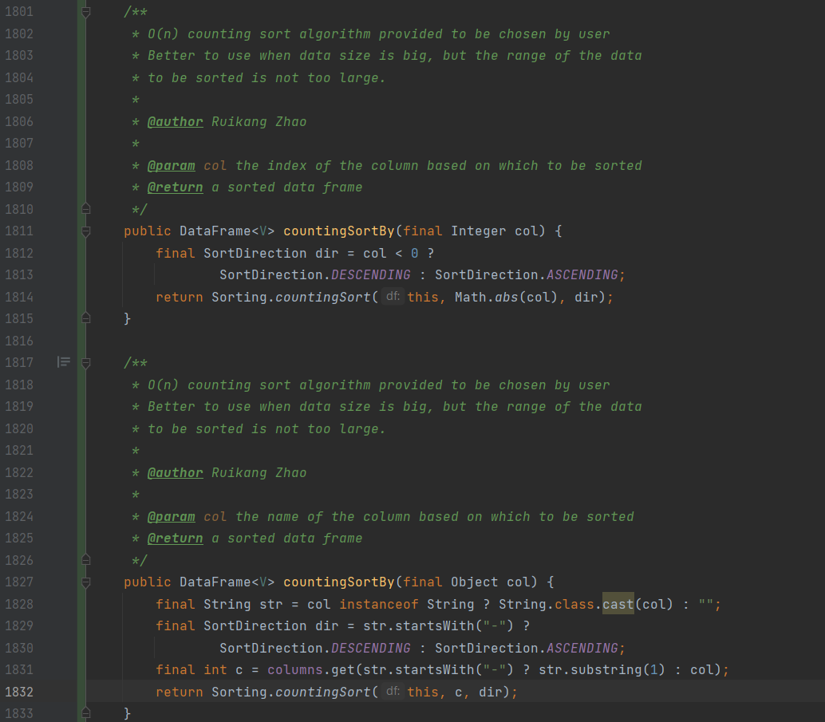
Joinery, Issue#40, Ruikang Zhao

Slide 36
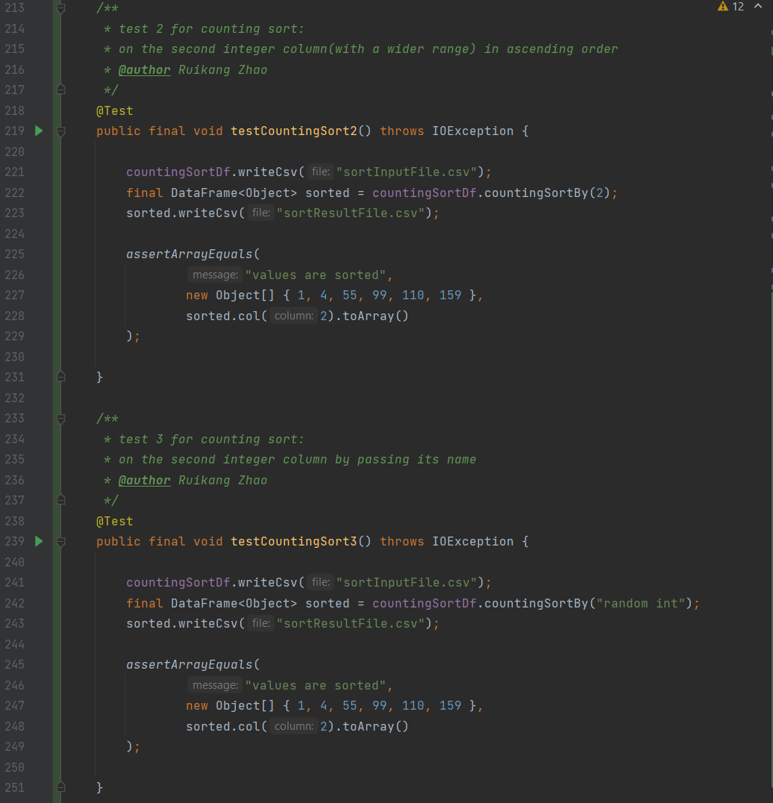
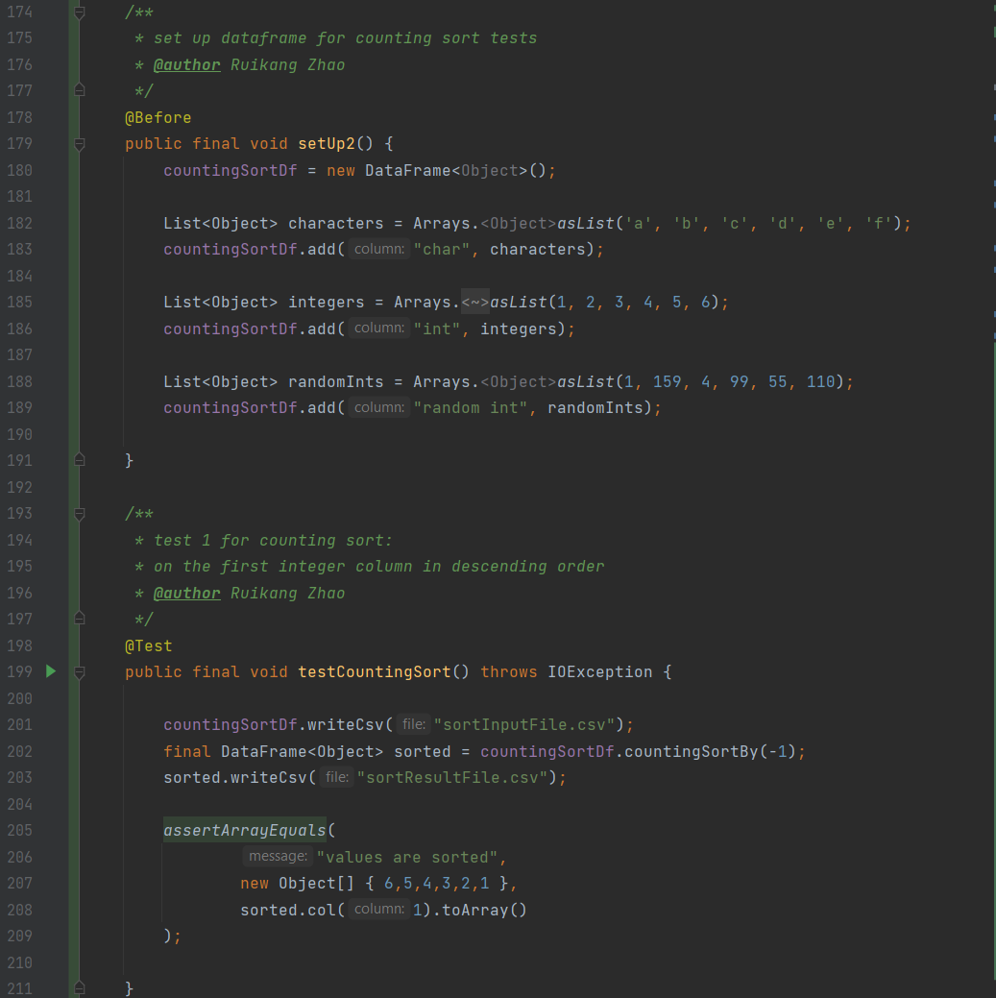
Joinery, Issue#40, Ruikang Zhao
Unit tests for countingSortBy:

Slide 37
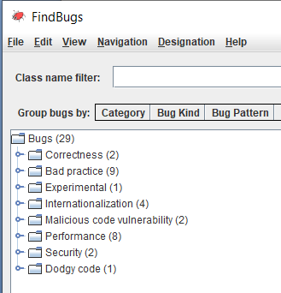
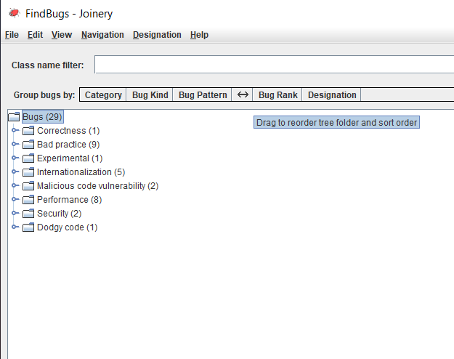
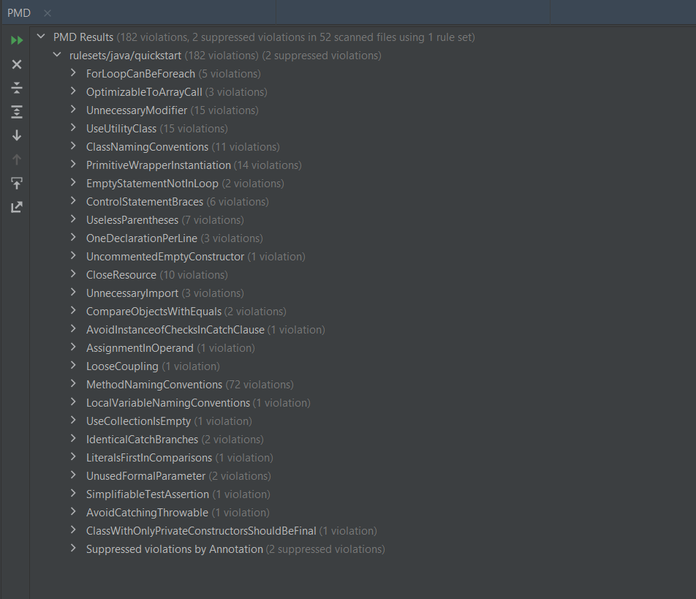
Joinery, Issue#40, Ruikang Zhao
Findbugs and PMD errors:
Original: After my implementation:
https://drive.google.com/file/d/1o_UpxXOkts2eeYCIvtsyd29-kV83pdr5/view?usp=sharing

Slide 38
Joinery, Issue#40, Ruikang Zhao
To sum up, the countingSort implementation is another sorting algorithm provided to be chosen by users that takes O(n) theoretically, but also affected by the range of the data to be sorted.
Therefore, it is better to use countingSort when data size is big, but the range of the data is not too large.

Slide 39
Joinery, Issue#86, Qin Qin and Ruikang Zhao
Project name | Issues implemented | Student netID | Lines changed | Date started | Date completed
Joinery | 86 | qinq2 ruikang2 | 0 | week 6 | None
Issue Description:
This issue seeks support on reading from and writing to the 2007+ version of excel file(.xlsx).
There is an existing pull request from a closed issue(#84), but it has not been merged into the main branch. We first attempt to reuse the code from issue#84 commits to verify the functionality.
We merged the code into our own version of Joinery, but it does not work for us.
Then we brought up this issue to our meeting, and we figured out that code from issue#84 commits only works for the previous version of Joinery, because a lot has changed since then.
We decided to provide our own implementation, and take issue#84 commits as a reference.
So far, we do not have more time for this issue.
Efforts shown in this progress log: https://docs.google.com/document/d/1q-9TX_hVCHDiKGaKy0sMJCMUcYugaIqA/edit

Slide 40
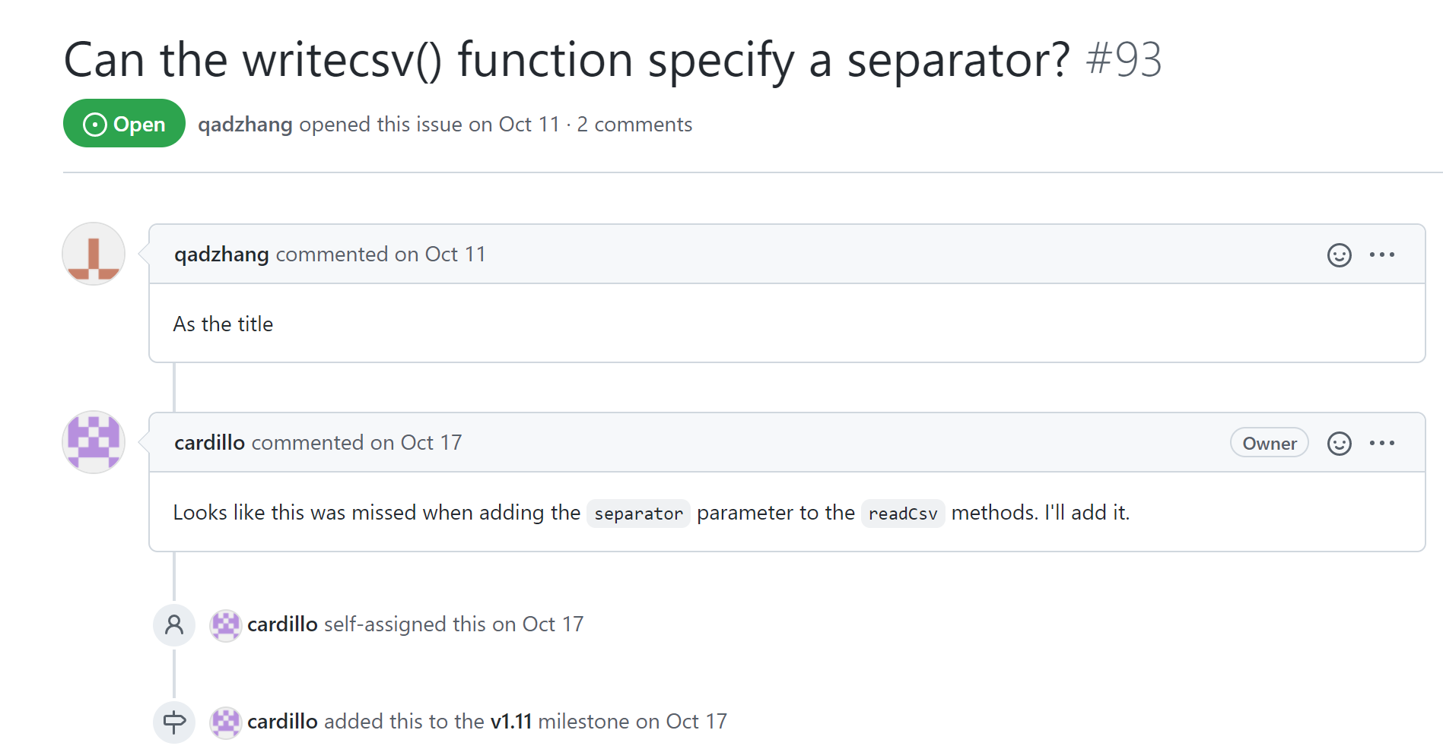
Joinery, #93, Qin Qin
Issue Description
Joinery has the writecsv() function, but someone asked to edit the function to specify a separator.

Slide 41
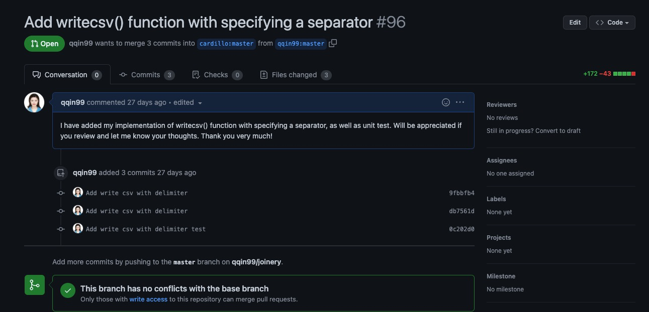
Joinery, #93, Qin Qin
Project name | Issues implemented | Student netID | Lines changed | Date started | Date completed
Joinery | 93 | qinq2 | +172, -43 | week 1 | week 6
Timeline
1 week to figure out how to build the project
1 weeks to read and understand related codes
2 weeks to identify and fix the issue.
2 weeks to write for tests cases and make sure there is no conflicts

Slide 42
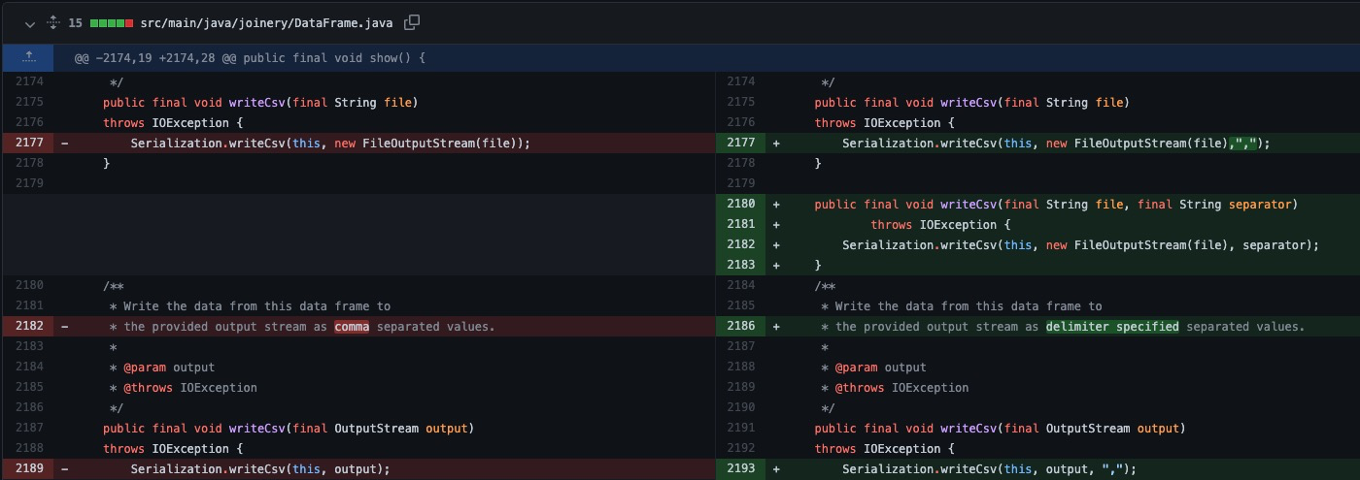
Joinery, #93, Qin Qin
Solution
In DataFrame.java file, in the original Serialization.writeCsv() function now I need to specify “,” as default if no separator is given. Then writeCsv() function which could be called in Joinery.jar is defined here with a separator.

Slide 43
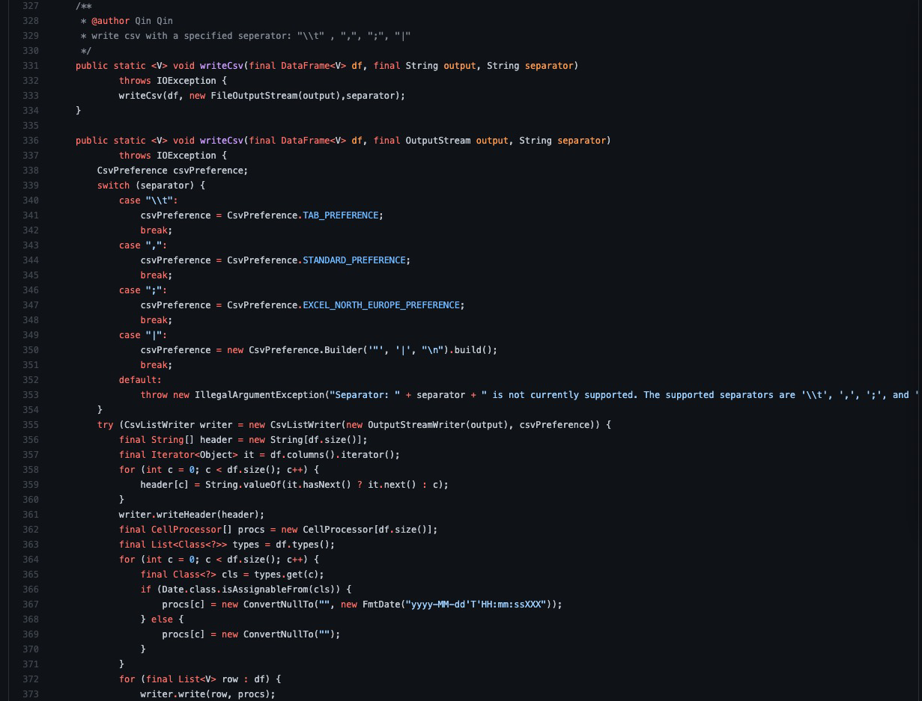
Joinery, #93, Qin Qin
Mainly used CsvListWriter and CsvPreferrence
Solution
I located the original writecsv() function without specify separator. I decided to overload the author’s code instead of deleting what she has already done. I need to write 2 functions: one writes with file, and the other one write with output stream

Slide 44
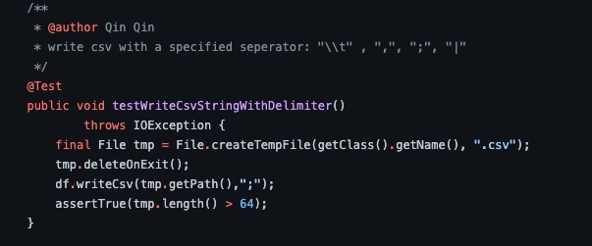
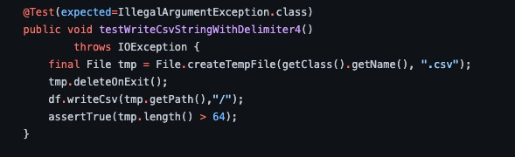
Joinery, # 93, Qin Qin
Solution: call the writecsv() method provided with separators
Test case scenario:
Write csv with 4 specified separators individually: "\\t" , ",", ";", "|", a temporary file should be created successfully
Write csv with unqualified separators “/”, an exception massage should be expected

Slide 45
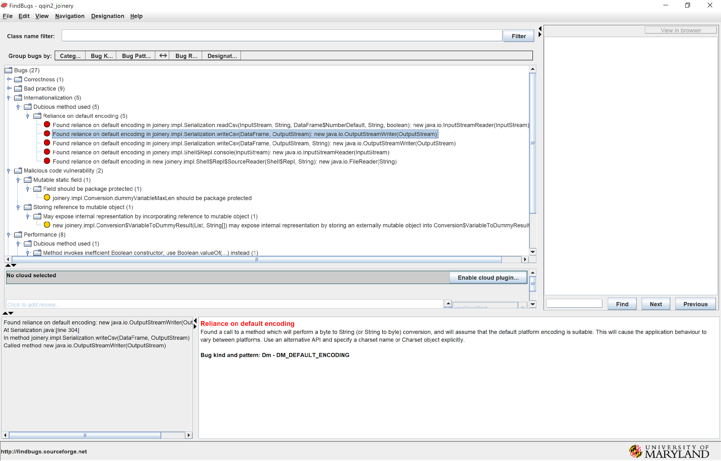
Joinery, #93, Qin Qin
FindBugs
The original one
After my fix: No new bug was introduced. I expanded each and checked.

Slide 46
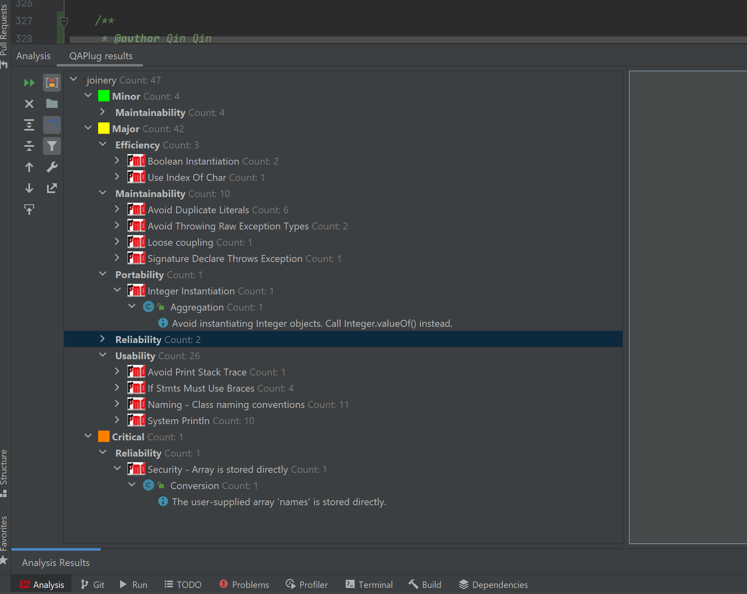
Joinery, #93, Qin Qin
PMD
All PMD errors are justifiable:
Some are false-positive and some is the legacy of the original repo, my codes did not generate any new.

Slide 47
Joinery, #93, Qin Qin
Concluding Remarks
○ Lessons learned:
I learned how github works, especially how it facilitates teamwork when everyone is working on the same project. What are the functions of git push, pull, merge, branch and etc.
I learned how CsvListWriter and CSV preference are used in Java.
○ Difficult:
Due to very limited experience with java, the understanding part is the hardest for me. But once I understand what is the project is doing and how it tries to realize it. Everything else went fluently.
○ What do you wish you could have done (or done differently)?
Due to limited experience, I did not pick all 3 issue properly. By the end, only one of them is feasible. And I am in a rush to find an alternative and also fix it in time. With better understanding of how open sourced project work, and how different issues mean, I will pick better issues and make better plan next time.
○ How could your project be extended...what's next? Are there any interesting problems or questions that resulted from your work?
I think the project could be extended to incorporate more functionality in R or Python like factors in R.

